Slide 1



以非週期性晶疇極化反轉鈮酸鋰晶體實現多波長光參量振盪器之電光選頻研究 Electro-optically spectral-line switchable in mutil-line optical parameter oscillators based on aperiodically poled lithium niobate
王泰傑 Tai-Jie Wang
指導教授： 陳彥宏 博士
Nonlinear Integrated Laser Photonics Lab (NILP),
Department of Optics and Photonics,
National Central University, Jhongli 320, Taiwan
Notes:
各位 口試委員 學長學弟大家好 我的論文題目為

Slide 2
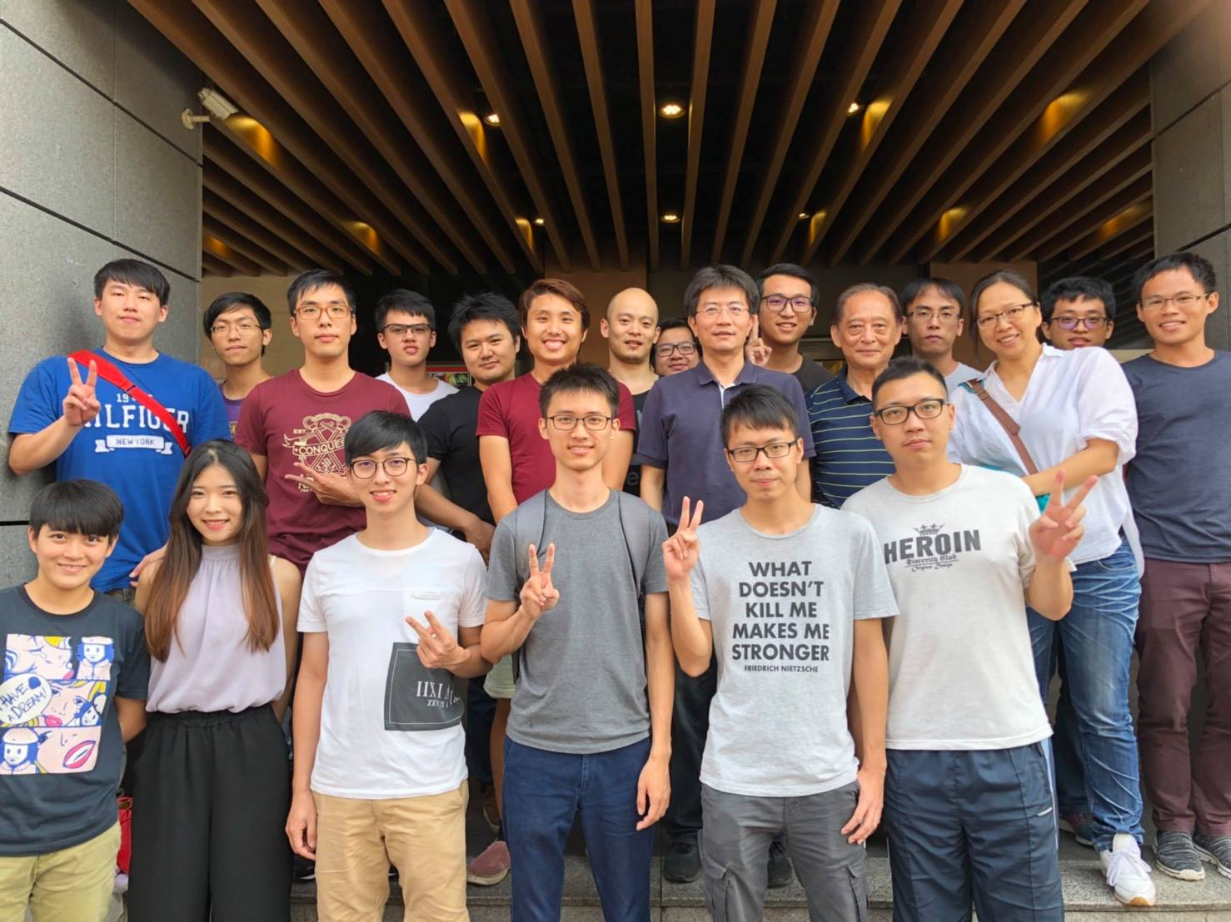
In this work
Outline
Introduction
Motivation
Electro-optically spectrum tailorable APPLN IOPOs
Working principles
Electro-Optic Polarization Mode Converters
Optical Parametric Oscillators
Design and Fabrication
Simulated Annealing Method
Mutil-line OPO design
Mutil-line EO PMC design
Fabrication process
Experimental Results and Analysis
EO PMC Experimental set-up
Measurement Results I
EO OPO APPLN Experimental set-up
Measurement Results II
Conclusions and future work
Notes:
這是我ppt 的outline 這次報告 我將分為五的部分進行介紹，首先第一部分為

Slide 3
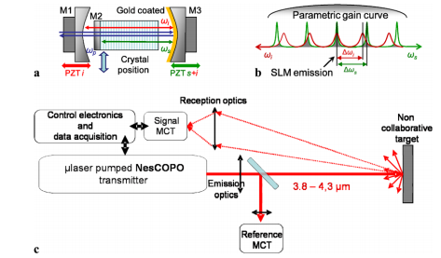
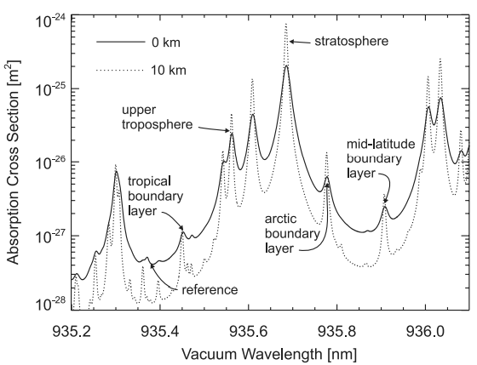
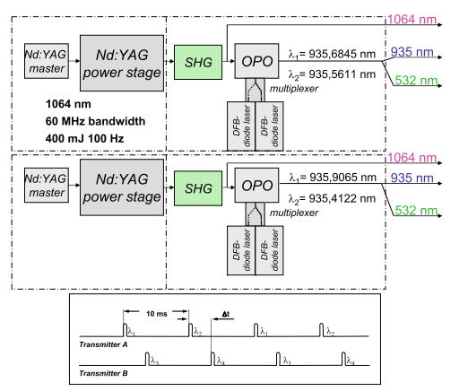
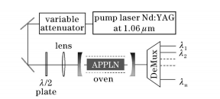
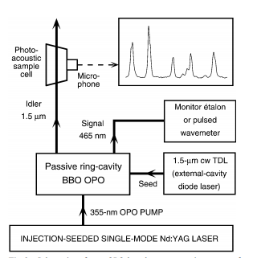
Introduction
Motivation
Remote sensing
Multi-λ differential absorption LIDAR (DIAL)
Appl. Phys. B 107 643–647 (2000)
Appl. Phys. B 96, 201-213 (2009)
Optical communication
Multi- λ spectroscopic
THz wave generation
Chinese optics letters, 3, 708 (2005)
Appl. Phys. B 71, 651–663 (2000)
Opt. Lett. 25, 1714 (2000)
Notes:
多波長選頻在許多領域都有廣泛的應用，如 搖感、光達、光通訊、光譜學等等
、而最常見的多波長選擇的方法，是在系統裡架設 偏振控制器、布拉格反射器等元件，而只要多一個元件、就會造成系統多餘損耗，而本實驗室使用的鈮酸鋰晶片能將多種元件整合在單一鈮酸鋰晶片上。有效改善系統造成的損耗。

Slide 4
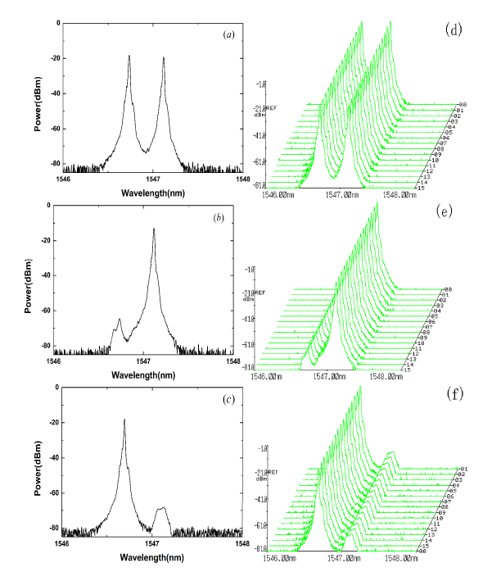
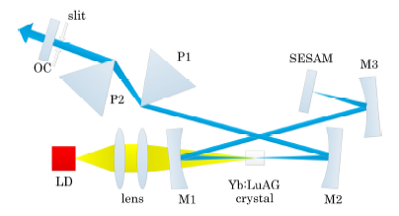
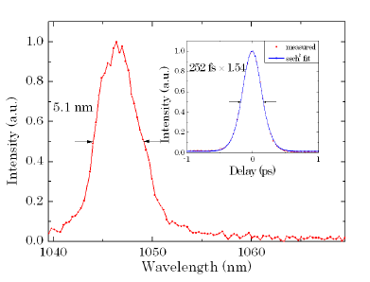
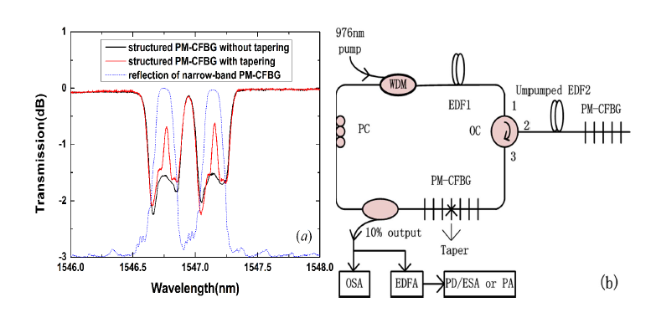
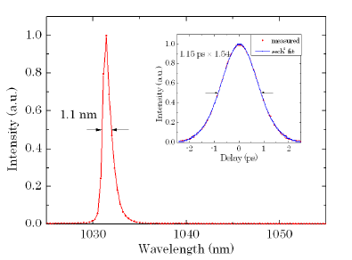
In this work
Motivation
Bin Yin, IEEE PHOTONICS TECHNOLOGY LETTERS, VOL. 26, NO. 12, JUNE 15, 2014
Weiyang Ge, 10 February 2014 | Vol. 22, No. 3 | DOI:10.1364/OE.22.002423 | OPTICS EXPRESS 2423
Notes:
1. polarization- maintaining-fiber-Bragg-gratings(PM-FBG)，ensure a stable operation of an SLM dual-wavelength erbium-doped fiber (EDF) laser
2.The mode locked laser wavelengthcould be switched between 1031 nm and 1046 nm by a slit.

Slide 5
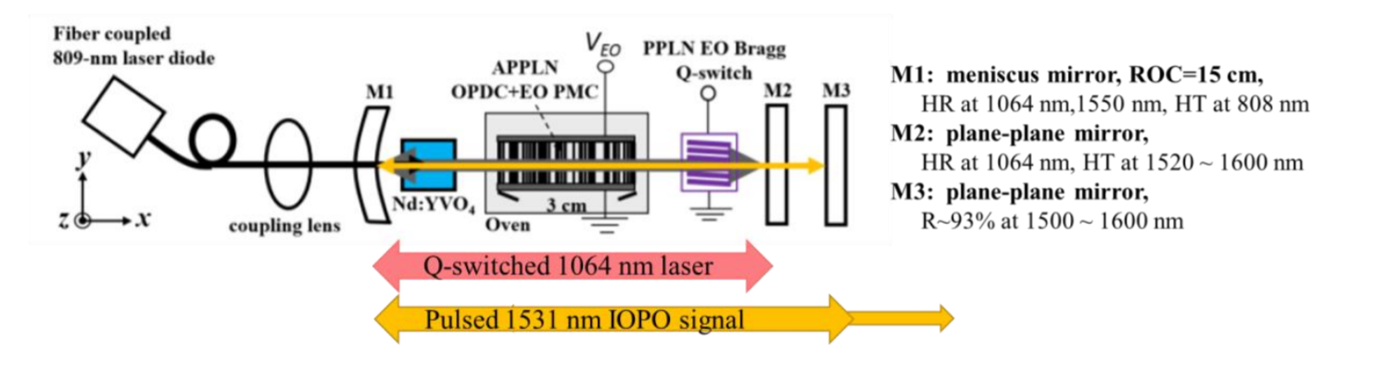
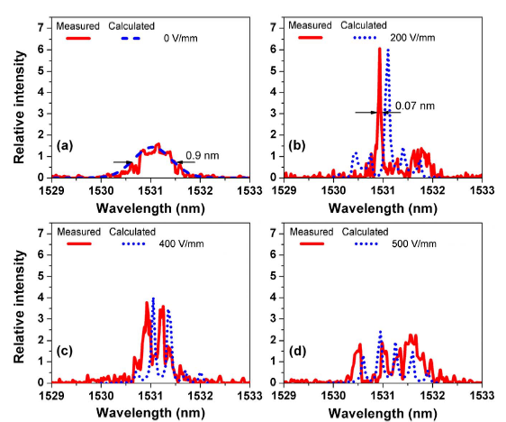
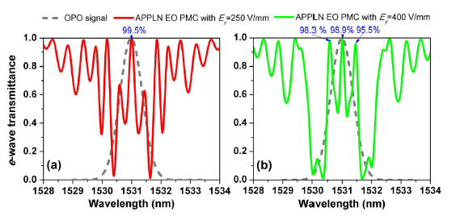
Prior works : Electro-optically spectrum tailorable APPLN IOPOs
At same temperature
Vol. 40, No. 22 / November 15 2015 / Optics Letters
Notes:
本實驗室鍾宏彬博士，成功將OPO與EO PMC 整合在單一APPLN晶體上，並成功達成OPO之窄頻。

Slide 6
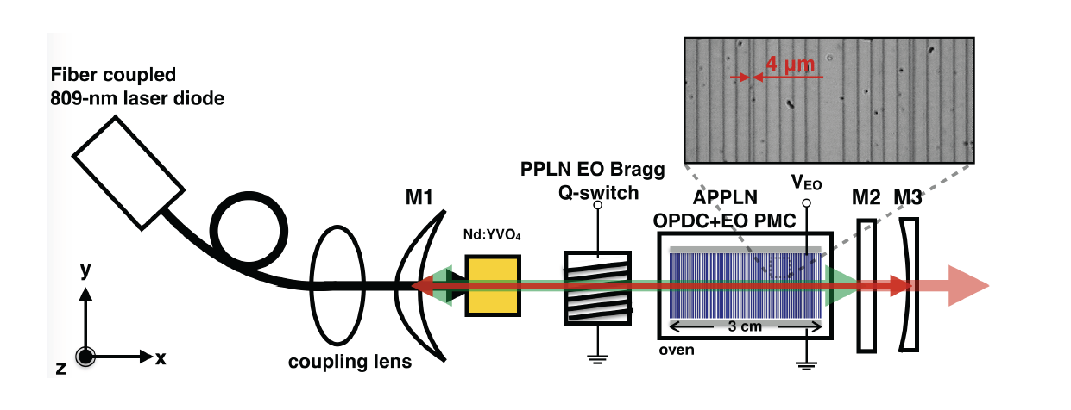
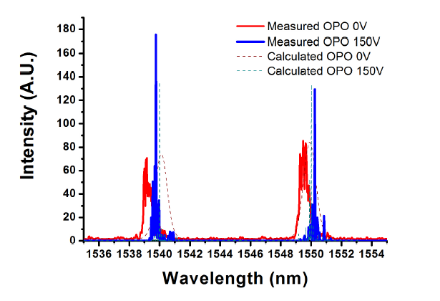
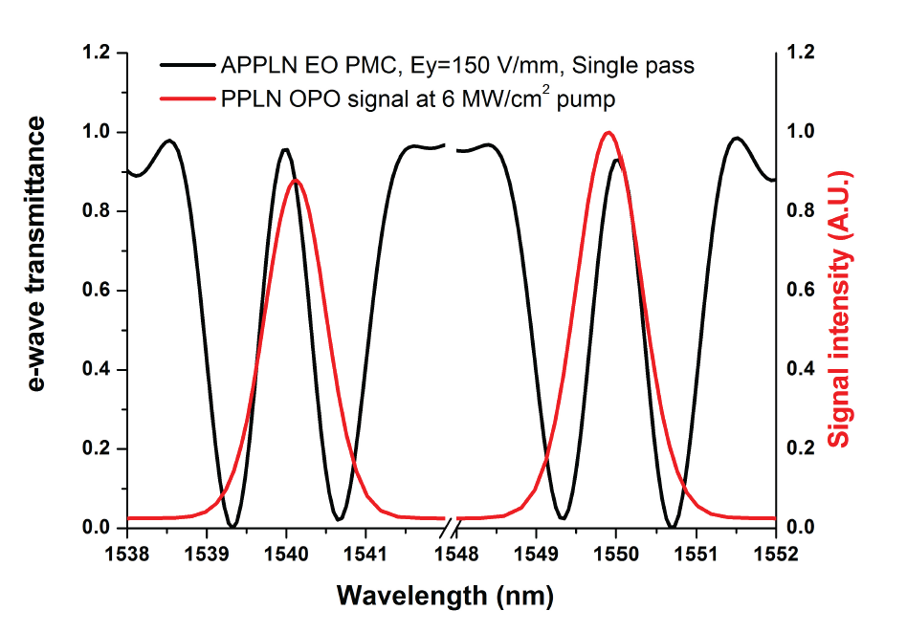
Prior works : Electro-optically spectrum tailorable APPLN IOPOs
At same temperature
中央大學 張煒堃博士論文
Notes:
本實驗室鍾宏彬博士，成功將OPO與EO PMC 整合在單一APPLN晶體上，並成功達成OPO之窄頻。

Slide 7
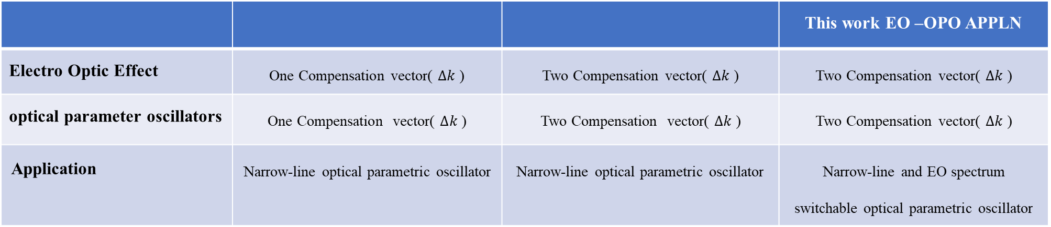
In this work
In this work : Electro-optically spectrum selectable APPLN OPOs
 |  |  | This work EO –OPO APPLN
Electro Optic Effect | One Compensation vector( $∆k$) | Two Compensation vector( $∆k$) | Two Compensation vector( $∆k$)
optical parameter oscillators | One Compensation vector( $∆k$) | Two Compensation vector( $∆k$) | Two Compensation vector( $∆k$)
Application | Narrow-line optical parametric oscillator | Narrow-line optical parametric oscillator | Narrow-line and EO spectrum switchable optical parametric oscillator
Prior works EO –OPO APPLN
Prior works EO –OPO APPLN
Mirror1
Mirror2
idlers
EO OPO - APPLN
signals
Pump
Notes:
在本實驗中，與先前實驗不同的是之前學長們都是做窄頻應用，而本實驗這次利用同樣的原理設計多波長選則之APLN

Slide 8
In this work
Outline
Introduction
Motivation
Electro-optically spectrum tailorable APPLN IOPOs
Working principles
Electro-Optic Polarization Mode Converters
Optical Parametric Oscillators
Design and Fabrication
Simulated Annealing Method
Mutil-line OPO design
Mutil-line EO PMC design
Fabrication process
Experimental Results and Analysis
EO PMC Experimental set-up
Measurement Results I
EO OPO APPLN Experimental set-up
Measurement Results II
Conclusions and future work
Notes:
這是我ppt 的outline 這次報告 我將分為五的部分進行介紹，首先第一部分為

Slide 9



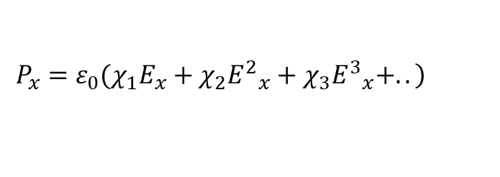
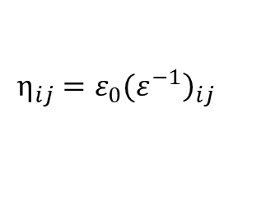




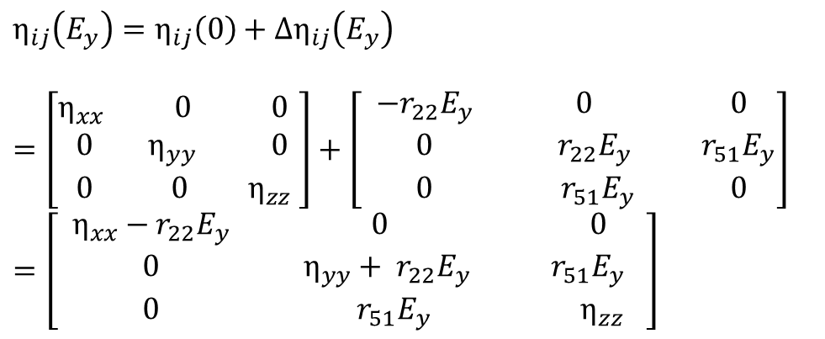





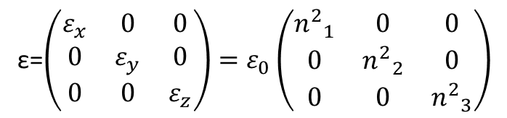
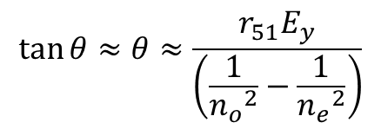

Working Principles
Electro-Optic Polarization Mode Converters (EO PMC)
$$\left.P_{x}=ε_{0}(χ_{1}E_{x}+χ_{2}{E^{2}}_{x}+χ_{3}{E^{3}}_{x}+..\right)$$
($\frac{1}{{n_{o}}^{2}}−r_{22}E_{y}$)$x^{2}$+($\frac{1}{{n_{o}}^{2}}+r_{22}E_{y}$)$y^{2}+\frac{1}{{n_{e}}^{2}}z^{2}$+2yz$r_{51}$=1
ε=$\left(\begin{matrix}ε_{x} & 0 & 0 \\ 0 & ε_{y} & 0 \\ 0 & 0 & ε_{z}\end{matrix}\right)=ε_{0}\left(\begin{matrix}{n^{2}}_{1} & 0 & 0 \\ 0 & {n^{2}}_{2} & 0 \\ 0 & 0 & {n^{2}}_{3}\end{matrix}\right)$
$$\tan{θ≈θ}≈\frac{r_{51}E_{y}}{\left(\frac{1}{{n_{o}}^{2}}−\frac{1}{{n_{e}}^{2}}\right)}$$
$$η_{ij}={\left.ε_{0}(ε^{−1}\right)}_{ij}$$
$$E_{y}$$
$$E_{y}$$
$$η_{ij}(\overset{⃑}{\left.E\right)}−η_{ij}\left(0\right)≡Δη_{ij}=r_{ijk}E_{k}+s_{ijk}E_{k}E_{l}$$
$$z_{p}$$
$$z$$
$$z$$
$(under Ey$)
$$\left(Original\right)$$
$$\left(Original\right)$$
$$z_{p}$$
$$η_{ij}\left(E_{y}\right)=η_{ij}\left(0\right)+Δη_{ij}\left(E_{y}\right)$$
$$=\left[\begin{aligned}&\begin{matrix}η_{xx} & 0 & 0 \\ 0 & η_{yy} & 0 \\ 0 & 0 & η_{zz}\end{matrix}\end{aligned} \right]+\left[\begin{aligned}&\begin{matrix} −r_{22}E_{y} & 0 & 0 \\ 0 & r_{22}E_{y} & r_{51}E_{y} \\ 0 & r_{51}E_{y} & 0\end{matrix}\end{aligned}\right]=\left[\begin{aligned}&\begin{matrix} η_{xx}−r_{22}E_{y} & 0 & 0 \\ 0 & η_{yy}+ r_{22}E_{y} & r_{51}E_{y} \\ 0 & r_{51}E_{y} & η_{zz}\end{matrix} \end{aligned}\right]$$
$(under Ey$)
$$θ$$
$$θ$$
y
Ps
Ps
y
$$y_{p}$$
$$y_{p}$$
Notes:
介電材料中，極化向量為 介電系數乘以電桿，
其中， 分別代表一階、二階與三階電感率 (electric susceptibility)
介質折射率為相對介電率的函數
由於鈮酸鋰晶體為非等向性電光材料，因此其介電系數可用張量表示，
定義一反介電張量矩陣，並外加Y場，並帶入折射率橢球 ，經過矩陣旋轉簡化 可得一角度，此角度為鈮酸鋰外加電場後，光軸偏轉的角度

Slide 10
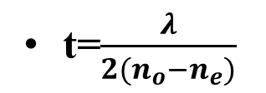


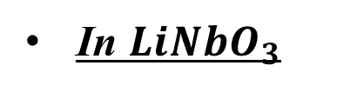

In this work
Electro-Optic Polarization Mode Converters (EO PMC)
Fold Šolc-type filter
In ${LiNbO}_{3}$
$$E_{y}$$
z
F
$$\frac{λ}{2} plate$$
z
$$θ$$
F
S
y
y
S
t
t=$\frac{λ}{2(n_{o}−n_{e})}$
Notes:
在1965 年Ivan Šolc所提出的論文中，利用一連串的雙折射晶體之平板，當每一片平板的長度都符合半波相位延遲板的長度t，當偏振光通過雙折射晶體，偏振會往光軸轉系塔角，可以改變經過光場的偏振模態。應用在鈮酸鋰晶體上面，藉由施加y方向電場，改變鈮酸鋰晶體光軸方向，將晶疇正負排列，則可以達到索爾克濾波器的效果。

Slide 11

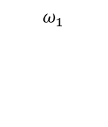














In this work
Optical Parametric Oscillators
$$I$$
$$ω_{1}$$
$$ω_{3}$$
$$χ^{(2)}$$
BPM
$$ω_{2}$$
QPM
1.Energy Conservation
$$ω_{3}=ω_{1}+ω_{2}$$
Non – phase - matching
2.Momentum Conservation
$$d/lc$$
$\overset{⃑}{k_{ω_{3}}}$=$\overset{⃑}{k_{ω_{1}}}+ \overset{⃑}{k_{ω_{2}}}$
Phase Mismatch
$$ω_{1}$$
$$Δk=k_{p}−k_{s}−k_{i}$$
$$ω_{3}$$
$$ω_{2}$$
$$\overset{⃑}{k_{ω_{1}}}$$
$$\overset{⃑}{k_{ω_{2}}}$$
$$\overset{⃑}{Δk}$$
$$\overset{⃑}{k_{ω_{3}}}$$
Notes:
第二階的非線性光學轉換機制，可由第二階非線性偏振項來解析，光參量振盪器為三光子的下轉換系統，其過程滿足能量守恆及動量守恆，將一顆高能光子，分解為兩顆波長較長，能量較低的兩顆光子，分別稱為波長較長稱為訊號波與較短為閒置波。且過程中，是在環境的真空雜訊（Vacuum Noise）中自行搜尋滿足相位匹配條件之種源（Seeding），作為初始訊號光，來進行單趟的放大，
其中能量守恆，在自然界中會自動匹配
動量守恆，需要藉由人為的方法來補償向為匹配，本實驗中使用準相位匹配技術來達成動量守恆。

Slide 12
In this work
In this work : Electro-optically spectrum selectable APPLN OPOs
Prior works EO –OPO APPLN
Prior works EO –OPO APPLN
Voltage
Mirror1
Mirror2
idlers
1540 nm & 1550 nm
signals
EO OPO - APPLN
1540 nm
Pump:1064nm
1550 nm
Design parameters
Crystal Length = 3cm
Phase Matching Temperature = 34 ℃
un
Pump Wavelength = 1064nm
Signal Wavelengths = 1540nm&1550nm
Notes:
在本實驗中，與先前實驗不同的是之前學長們都是做窄頻應用，而本實驗這次利用同樣的原理設計多波長選則之APLN

Slide 13
In this work
Outline
Introduction
Motivation
Electro-optically spectrum tailorable APPLN IOPOs
Working principles
Electro-Optic Polarization Mode Converters
Optical Parametric Oscillators
Design and Fabrication
Simulated Annealing Method
Mutil-line OPO design
Mutil-line EO PMC design
Fabrication process
Experimental Results and Analysis
EO PMC Experimental set-up
Measurement Results I
EO OPO APPLN Experimental set-up
Measurement Results II
Conclusions and future work
Notes:
這是我ppt 的outline 這次報告 我將分為五的部分進行介紹，首先第一部分為

Slide 14
Design and Fabrication
Design
Fabrication
Start
Initial Multi- λ EO OPO setting(under 1064 nm pump)
Mask
New MEO Filter setting
(Number / λj / weighting)
Simulated Annealing algorithm (SA)
Lithography
Electric-field poling
The EO OPO Spectrum Intra-cavity Simulation
Optimal Aperiodic Structure
End-face polishing
Doesn’t meet the design
EO OPO spectrum output
Meets the design
Final aperiodic Structure output
End

Slide 15
In this work
Simulated Annealing Method (SA)
Concept
Annealing
High temperature
Low temperature
High Energy
Low Energy

Slide 16
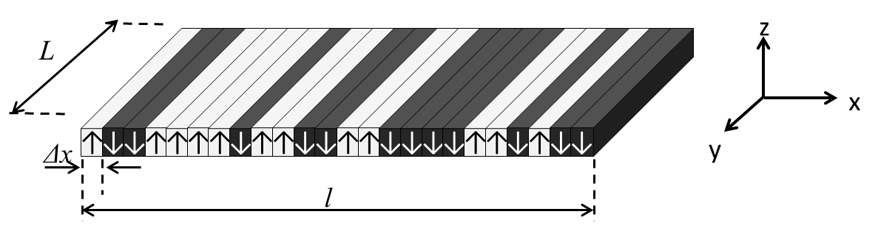
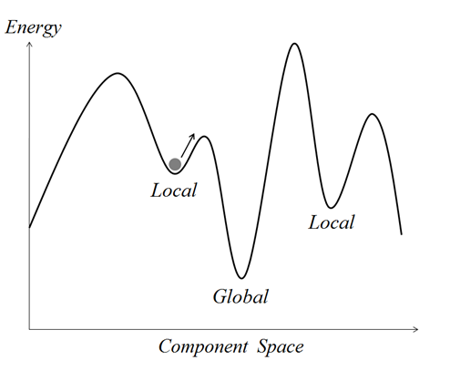


In this work
Simulated Annealing Method (SA)
Initial Condition:
start
N=Block Number
T=Annealing Temperature
Tre=Reduction Factor for T
Intitial Condition
Domain(j)=-1, for all j
Domain(j), j=0
Objective Function(Ob) Calculation, Ob(0)
J=j+1
Domain(j)=-domain(j)
no
yes
1.Cp<0
Domain(j)=-domain(j)
or
$$2.ρ<exp(−Cp/T)$$
J=1
Cp=Ob(j)-Ob(j-1)
Ob(0)=Ob(j)
j>N
no
Objective Function(Ob) Calculation, Ob(j)
yes
yes
T=T$×Tre$
Does any domain change?
no
End

Slide 17


In this work
Simulated Annealing Method (SA)
Initial Condition:
start
N=Block Number
T=Annealing Temperature
Tre=Reduction Factor for T
Intitial Condition
Domain(j)=-1, for all j
Domain(j), j=0
Objective Function(Ob) Calculation, Ob(0)
J=j+1
Domain(j)=-domain(j)
no
yes
1.Cp<0
Domain(j)=-domain(j)
or
$$2.ρ<exp(−Cp/T)$$
J=1
Cp=Ob(j)-Ob(j-1)
Ob(0)=Ob(j)
j>N
no
Objective Function(Ob) Calculation, Ob(j)
yes
yes
T=T$×Tre$
Does any domain change?
no
End

Slide 18
In this work
Simulated Annealing Method (SA)
Initial Condition:
start
N=Block Number
T=Annealing Temperature
Tre=Reduction Factor for T
Intitial Condition
Domain(j)=-1, for all j
Domain(j), j=0
Objective Function(Ob) Calculation, Ob(0)
J=j+1
Domain(j)=-domain(j)
no
yes
1.Cp<0
Domain(j)=-domain(j)
or
$$2.ρ<exp(−Cp/T)$$
J=1
Cp=Ob(j)-Ob(j-1)
Ob(0)=Ob(j)
j>N
no
Objective Function(Ob) Calculation, Ob(j)
yes
yes
T=T$×Tre$
Does any domain change?
no
End

Slide 19
In this work
Simulated Annealing Method (SA)
Initial Condition:
start
N=Block Number
T=Annealing Temperature
Tre=Reduction Factor for T
Intitial Condition
Domain(j)=-1, for all j
Domain(j), j=0
Objective Function(Ob) Calculation, Ob(0)
J=j+1
Domain(j)=-domain(j)
no
yes
1.Cp<0
Domain(j)=-domain(j)
or
$$2.ρ<exp(−Cp/T)$$
J=1
Cp=Ob(j)-Ob(j-1)
Ob(0)=Ob(j)
j>N
no
Objective Function(Ob) Calculation, Ob(j)
yes
yes
T=T$×Tre$
Does any domain change?
no
End

Slide 20
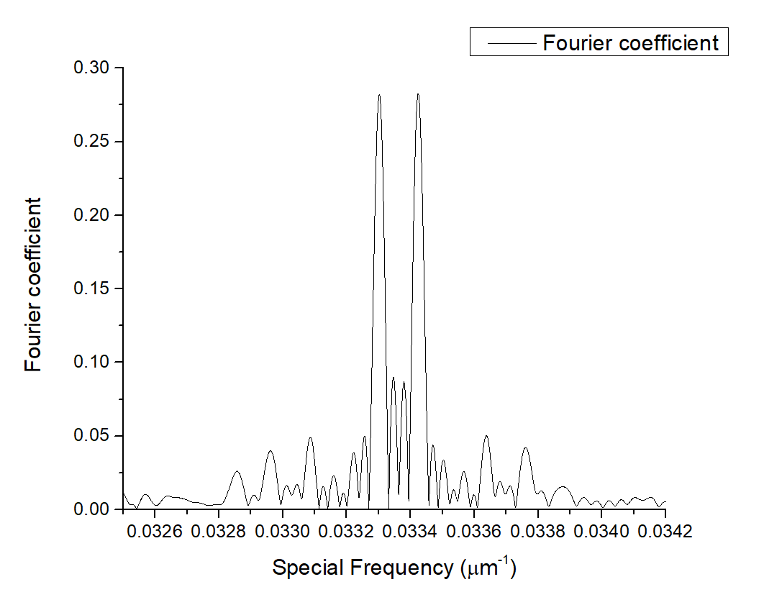
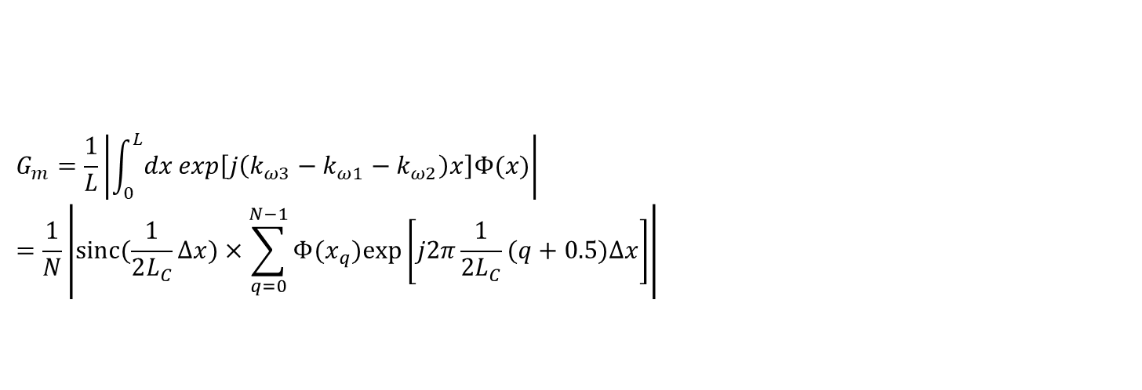
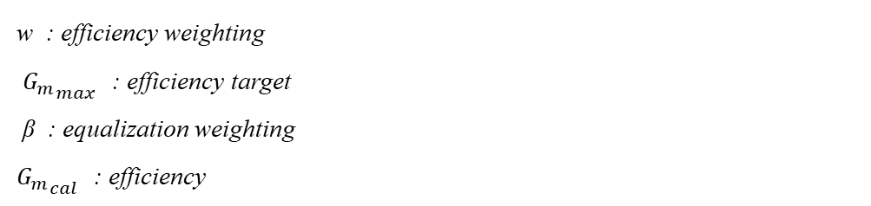
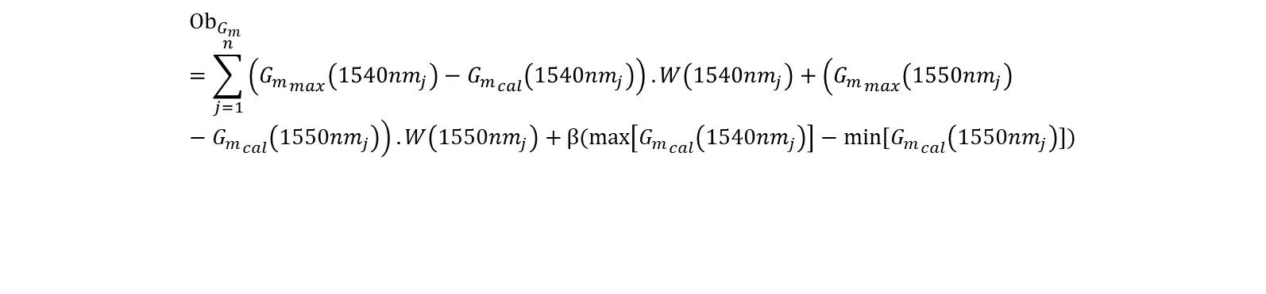
In this work
APPLN Optical Parametric Oscillator
Effective Nonlinear Coefficient
N : unit block number
L_{c} : coherence length
L : crystal length
Δx : unit block length
$$G_{m}=\frac{1}{L}\left|\int_{0}^{L}{dx}exp\left[j\left(k_{ω3}−k_{ω1}−k_{ω2}\right)x\right]Φ(x)\right|=\frac{1}{N}\left|\operatorname{sinc}{(\frac{1}{2L_{C}}∆x)×\sum_{q=0}^{N−1}{Φ(x_{q})exp⁡\left[j2π\frac{1}{2L_{C}}(q+0.5)∆x\right]}}\right|$$
$${Ob}_{G_{m}}=\sum_{j=1}^{n}{\left({G_{m}}_{max}\left({1540nm}_{j}\right)−{G_{m}}_{cal}\left({1540nm}_{j}\right)\right).W\left({1540nm}_{j}\right)+\left({G_{m}}_{max}\left({1550nm}_{j}\right)−{G_{m}}_{cal}\left({1550nm}_{j}\right)\right).W\left({1550nm}_{j}\right)+}β(\max\left[{G_{m}}_{cal}\left({1540nm}_{j}\right)\right]−min[{G_{m}}_{cal}\left({1550nm}_{j}\right)])$$
w : efficiency weighting
${G_{m}}_{max}$ : efficiency target
β : equalization weighting
${G_{m}}_{cal}$ : efficiency
${ Gm}_{1540nm}$= 0.2822${ Gm}_{1550nm}$ = 0.2828

Slide 21
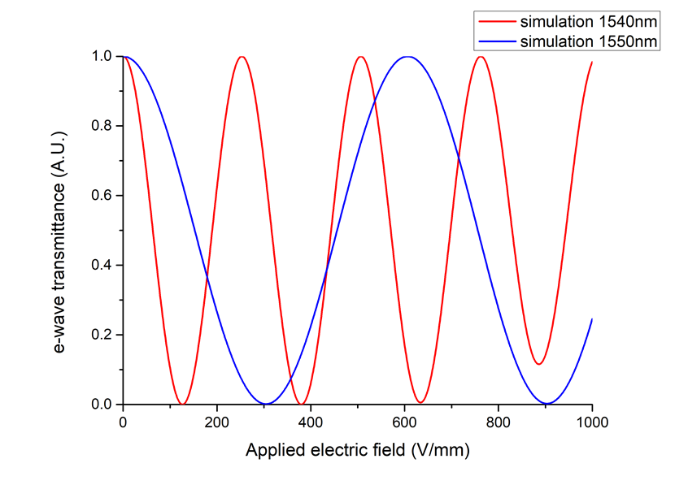

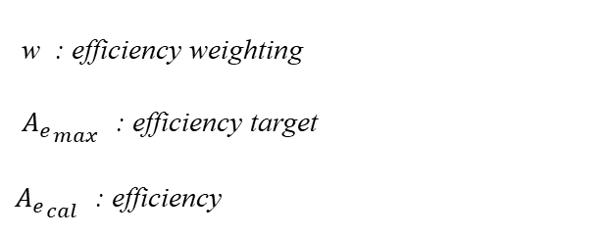
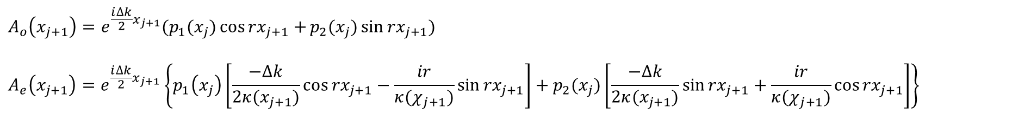






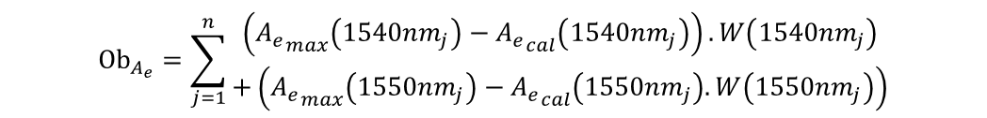
In this work
APPLN Electro-Optic Polarization Mode Converter
Co-directional coupled mode equations
$$A_{o}\left(x_{j}\right)$$
$$A_{o}\left(x_{j+1}\right)$$
$$A_{e}\left(x_{j}\right)$$
$$A_{e}\left(x_{j+1}\right)$$
$$A_{o}\left(x_{j+1}\right)=e^{\frac{i∆k}{2}x_{j+1}}(p_{1}(x_{j})\cos{{rx}_{j+1}+}p_{2}(x_{j})\sin{{rx}_{j+1}})$$
$$A_{e}\left(x_{j+1}\right)=e^{\frac{i∆k}{2}x_{j+1}}\left\{p_{1}\left(x_{j}\right)\left[\frac{−∆k}{2κ(x_{j+1})}cos{{rx}_{j+1}−\frac{ir}{κ(χ_{j+1})}\sin{{rx}_{j+1}}}\right]+p_{2}(x_{j})\left[\frac{−∆k}{2κ(x_{j+1})}sin{{rx}_{j+1}+\frac{ir}{κ(χ_{j+1})}\cos{{rx}_{j+1}}}\right]\right\}$$
$${ x=x}_{j}$$
$${ x=x}_{j+1}$$
Objective Function
$${Ob}_{A_{e}}=\sum_{j=1}^{n}{\begin{aligned}\left({A_{e}}_{max}\left({1540nm}_{j}\right)−{A_{e}}_{cal}\left({1540nm}_{j}\right)\right).W\left({1540nm}_{j}\right) \\ +\left({A_{e}}_{max}\left({1550nm}_{j}\right)−{A_{e}}_{cal}\left({1550nm}_{j}\right).W\left({1550nm}_{j}\right)\right)\end{aligned}}$$
w : efficiency weighting
${A_{e}}_{max}$ : efficiency target
${A_{e}}_{cal}$ : efficiency
${Ob}_{total}={W_{OPO}.Ob}_{G_{m}}$+ $W_{EO}. {Ob}_{A_{e}}$

Slide 22
In this work
APPLN Electro-Optic Polarization Mode Converter
Co-directional coupled mode equations
$$A_{o}\left(x_{j}\right)$$
$$A_{o}\left(x_{j+1}\right)$$
$$A_{e}\left(x_{j}\right)$$
$$A_{e}\left(x_{j+1}\right)$$
$$A_{o}\left(x_{j+1}\right)=e^{\frac{i∆k}{2}x_{j+1}}(p_{1}(x_{j})\cos{{rx}_{j+1}+}p_{2}(x_{j})\sin{{rx}_{j+1}})$$
$$A_{e}\left(x_{j+1}\right)=e^{\frac{i∆k}{2}x_{j+1}}\left\{p_{1}\left(x_{j}\right)\left[\frac{−∆k}{2κ(x_{j+1})}cos{{rx}_{j+1}−\frac{ir}{κ(χ_{j+1})}\sin{{rx}_{j+1}}}\right]+p_{2}(x_{j})\left[\frac{−∆k}{2κ(x_{j+1})}sin{{rx}_{j+1}+\frac{ir}{κ(χ_{j+1})}\cos{{rx}_{j+1}}}\right]\right\}$$
$${ x=x}_{j}$$
$${ x=x}_{j+1}$$
Ob Setting
Objective Function
$${Ob}_{A_{e}}=\sum_{j=1}^{n}{\begin{aligned}\left({A_{e}}_{max}\left({1540nm}_{j}\right)−{A_{e}}_{cal}\left({1540nm}_{j}\right)\right).W\left({1540nm}_{j}\right) \\ +\left({A_{e}}_{max}\left({1550nm}_{j}\right)−{A_{e}}_{cal}\left({1550nm}_{j}\right).W\left({1550nm}_{j}\right)\right)\end{aligned}}$$
0.7579
w : efficiency weighting
${A_{e}}_{max}$ : efficiency target
${A_{e}}_{cal}$ : efficiency
0.1047
${Ob}_{total}={W_{OPO}.Ob}_{G_{m}}$+ $W_{EO}. {Ob}_{A_{e}}$

Slide 23
In this work
APPLN Electro-Optic Polarization Mode Converter
Co-directional coupled mode equations
$$A_{o}\left(x_{j}\right)$$
$$A_{o}\left(x_{j+1}\right)$$
$$A_{e}\left(x_{j}\right)$$
$$A_{e}\left(x_{j+1}\right)$$
$$A_{o}\left(x_{j+1}\right)=e^{\frac{i∆k}{2}x_{j+1}}(p_{1}(x_{j})\cos{{rx}_{j+1}+}p_{2}(x_{j})\sin{{rx}_{j+1}})$$
$$A_{e}\left(x_{j+1}\right)=e^{\frac{i∆k}{2}x_{j+1}}\left\{p_{1}\left(x_{j}\right)\left[\frac{−∆k}{2κ(x_{j+1})}cos{{rx}_{j+1}−\frac{ir}{κ(χ_{j+1})}\sin{{rx}_{j+1}}}\right]+p_{2}(x_{j})\left[\frac{−∆k}{2κ(x_{j+1})}sin{{rx}_{j+1}+\frac{ir}{κ(χ_{j+1})}\cos{{rx}_{j+1}}}\right]\right\}$$
$${ x=x}_{j}$$
$${ x=x}_{j+1}$$
Objective Function
1
1
$${Ob}_{A_{e}}=\sum_{j=1}^{n}{\begin{aligned}\left({A_{e}}_{max}\left({1540nm}_{j}\right)−{A_{e}}_{cal}\left({1540nm}_{j}\right)\right).W\left({1540nm}_{j}\right) \\ +\left({A_{e}}_{max}\left({1550nm}_{j}\right)−{A_{e}}_{cal}\left({1550nm}_{j}\right).W\left({1550nm}_{j}\right)\right)\end{aligned}}$$
w : efficiency weighting
${A_{e}}_{max}$ : efficiency target
${A_{e}}_{cal}$ : efficiency
0.07
0.1108
${Ob}_{total}={W_{OPO}.Ob}_{G_{m}}$+ $W_{EO}. {Ob}_{A_{e}}$

Slide 24

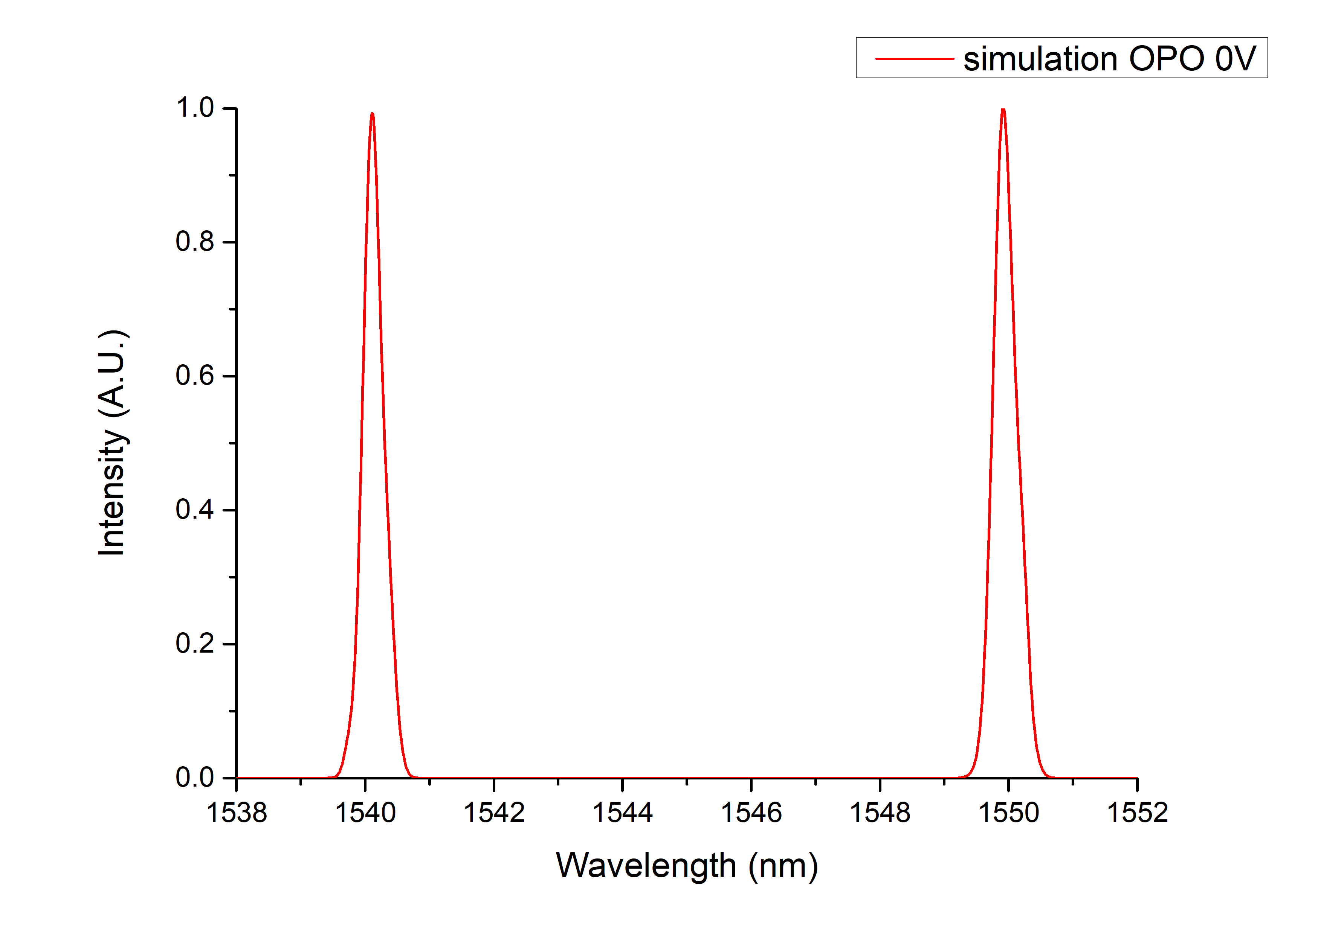
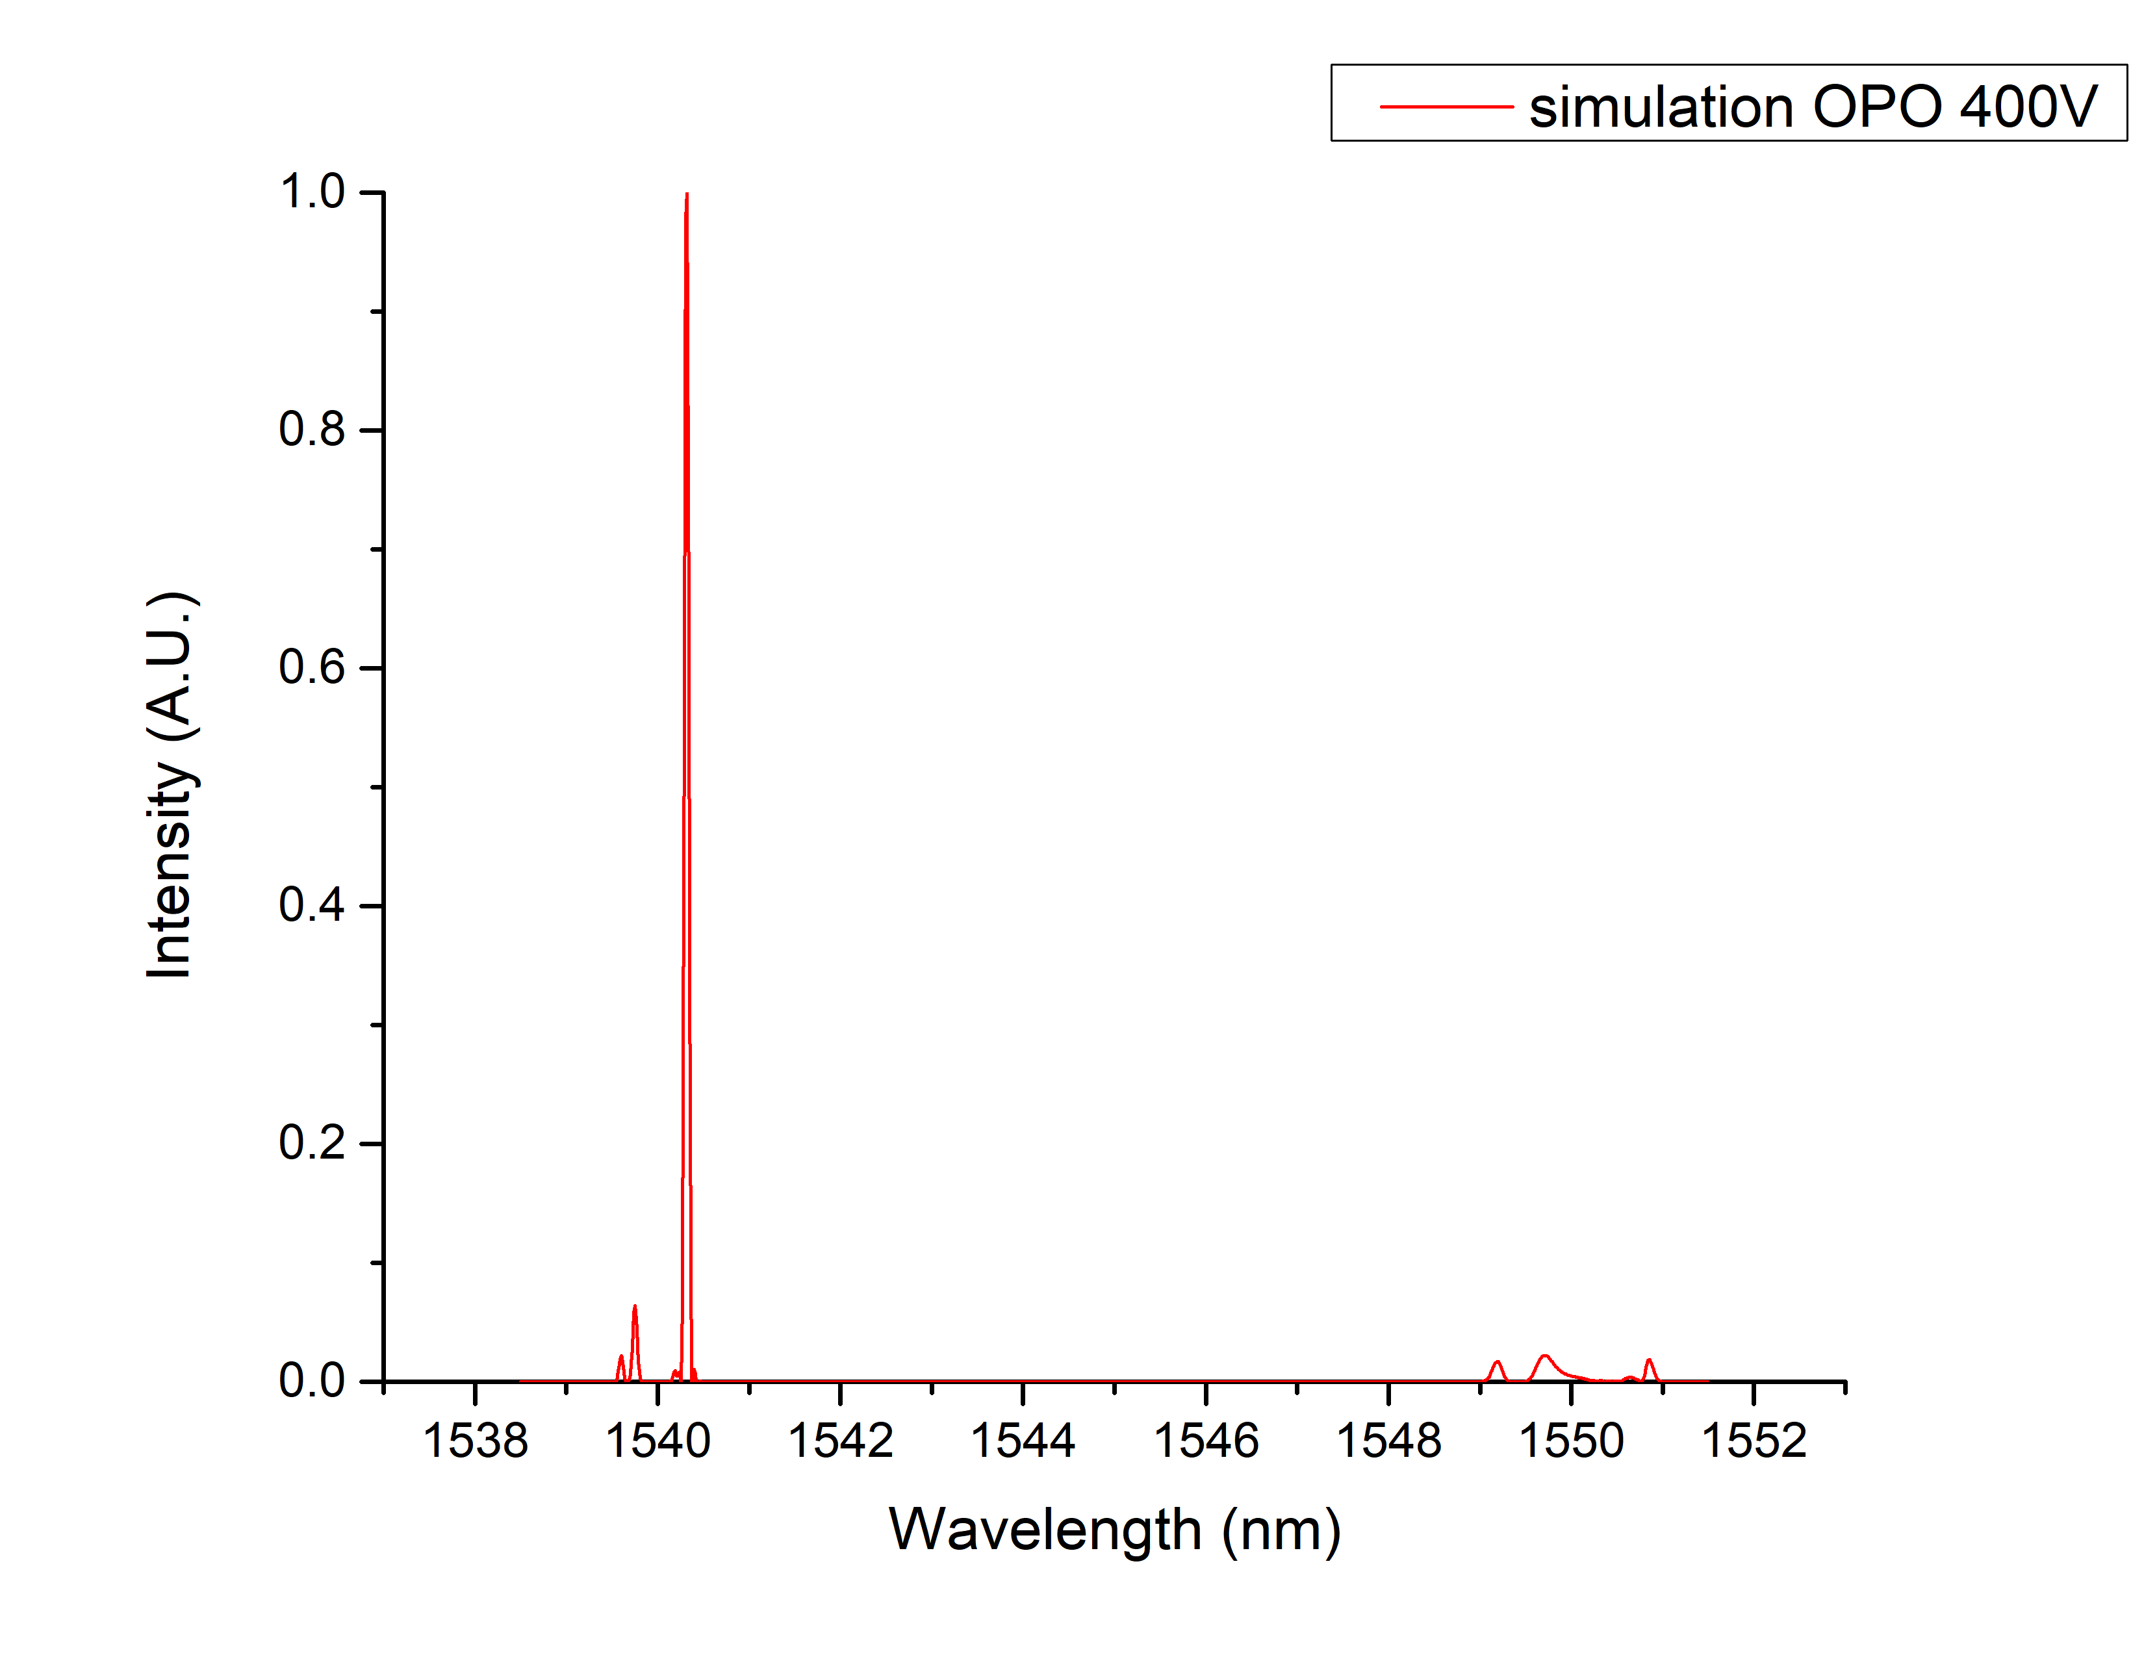
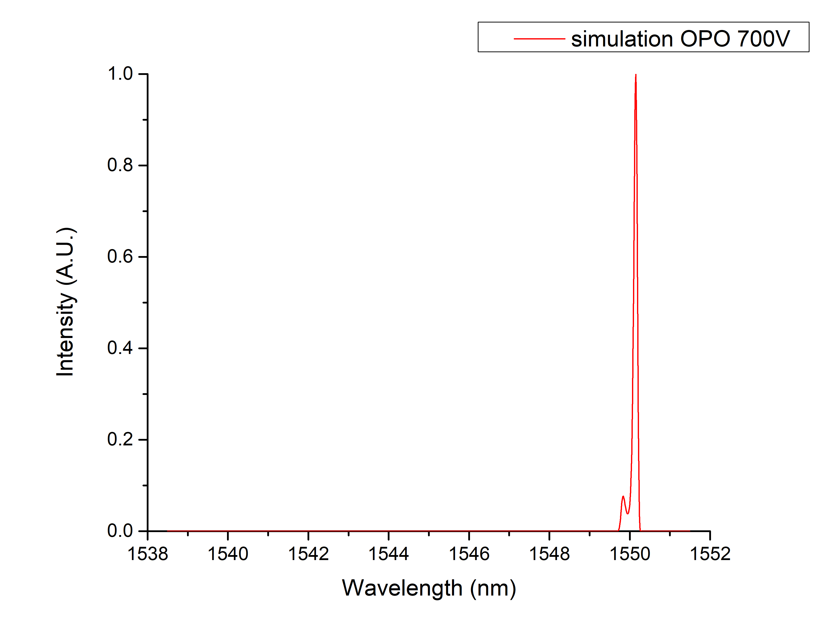




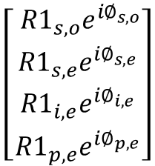





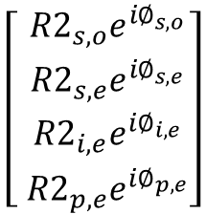

In this work
EO OPO Cavity Simulation
Mirror 1
Mirror 2
中央大學光電所 鐘宏彬博士論文
Multi-OPO and Multi-EO PMC APPLN
1064 nm pump
OPO signal
$$\left[{M1}_{w,q}\right]$$
$$\left[E_{w,q}(0)\right]$$
$$\left[E_{w,q}({x=x}_{j},E_{y})\right]$$
$$\left[E_{w,q}(x=L)\right]$$
$$\left[{M2}_{w,q}\right]$$
$$w=signal,idler,pump$$
For one Round-Trip :
$$q=o,e$$
$$\left[\begin{matrix}{ R1}_{s,o}e^{i∅_{s,o}} \\ {R1}_{s,e}e^{i∅_{s,e}} \\ {R1}_{i,e}e^{i∅_{i,e}} \\ {R1}_{p,e}e^{i∅_{p,e}}\end{matrix}\right]$$
$$\left[\begin{matrix}E_{s,o}(0) \\ E_{s,e}(0) \\ E_{i,e}(0) \\ E_{p,e}(0)\end{matrix}\right]$$
$$\left[\begin{matrix}E_{s,o}(x=x_{j},E_{y}) \\ E_{s,e}(x=x_{j},E_{y}) \\ E_{i,e}(x=x_{j},E_{y}) \\ E_{p,e}(x=x_{j},E_{y})\end{matrix}\right]$$
$$\left[\begin{matrix}E_{s,o}(x=L) \\ E_{s,e}(x=L) \\ E_{i,e}(x=L) \\ E_{p,e}(x=L)\end{matrix}\right]$$
$$\left[ \begin{matrix}{R2}_{s,o}e^{i∅_{s,o}} \\ {R2}_{s,e}e^{i∅_{s,e}} \\ {R2}_{i,e}e^{i∅_{i,e}} \\ {R2}_{p,e}e^{i∅_{p,e}}\end{matrix}\right]$$
Simulation result

Slide 25

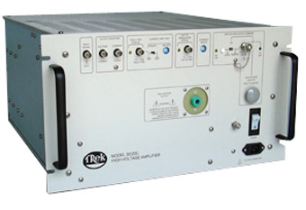
In this work
Fabrication process
Clean the chip
PR coating
Soft bake
Poling
Hard bake
Exposure and development
Computer
UV light
High Voltage
Trek 20/20C
Ground

Slide 26
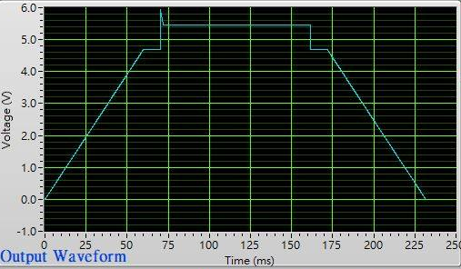

In this work
Poling Fabrication
Applied Voltage Waveform
Set up
Computer
High Voltage
APPLN etching
Trek 20/20C
Ground

Slide 27

In this work
Process
晶片切割
晶片切割
端面拋光研磨
鍍膜
Final product

Slide 28
In this work
Outline
Introduction
Motivation
Electro-optically spectrum tailorable APPLN IOPOs
Working principles
Electro-Optic Polarization Mode Converters
Optical Parametric Oscillators
Design and Fabrication
Simulated Annealing Method
Mutil-line OPO design
Mutil-line EO PMC design
Fabrication process
Experimental Results and Analysis
EO PMC Experimental set-up
Measurement Results I
EO OPO APPLN Experimental set-up
Measurement Results II
Conclusions and future work
Notes:
這是我ppt 的outline 這次報告 我將分為五的部分進行介紹，首先第一部分為

Slide 29




In this work
Single-pass experiment
Experimental set up
ECL
f=150
PC
EO OPO APPLN
PBS
objectives lens
Experimental Error
Simulation
Measurement
Add Poling error under poled 2 μm ~4 μm
Add Temperature difference ΔT=0.2 ℃
Add Electro-Optic Coefficients $r_{51}$=24pm/V
un
V_{π}1540nm~253V/mm
V_{π}1550nm~606V/mm
V_{π}1540nm~350V/mm
V_{π}1550nm~850V/mm

Slide 30


Experimental Setup
Q - switched 1064nm laser
R1
M2
f=250mm
Power Supply
M1
R2
PBS
Isolator
Iris
EO-OPO APPLN
$λ/2$plate
InnoSlab Q -Switched Laser (1064nm)
Highest beam quality $M^{2}:1.1$
Pulse width : 13.6ns
Polarisation: >100:1
Time stability(ns): 5
Energy stability(%) rms :1
Repetition(kHz) : 1
M1: Meniscus mirror; ROC=100mm T~92%@1064nm, HR~99%@1550nm
M2: Pl/Pl mirror; T~96%@1064nm, PR~94%@1550nm

Slide 31






In this work
EO OPO Spectrum measurements
Temperature Controller:34.9 ℃
NO applied electric field
Applied electric field 360V/mm
Applied electric field 790V/mm
Center wavelength:1539.77nm&1549.95nm
FWHM:0.58nm&0.44nm
Pulse energy :0.235$μ$J
Center wavelength:1539.90nm
FWHM:0.09nm
Pulse energy :0.254$μ$J
Center wavelength:1549.87nm
FWHM:0.09nm
Pulse energy :0.253$μ$J

Slide 32


In this work
Simulation fitting
Simulation setting temperature: 34℃
Simulation added poling error : 2 μm ~4 μm
Center wavelength difference 0.42nm

Slide 33






In this work
Pump power working range
Temperature: 34.9℃
Pump power : 6.3kW
Pump power : 7.0kW
Pump power : 7.6kW
Applied electric field 360V/mm
Applied electric field 790V/mm

Slide 34






In this work
Electric field working range
Temperature: 34.9℃
Pump power : 7kW
Working range 50V
Working range 250V

Slide 35






In this work
Temperature Tolerance
Pump power : 7kW
Applied electric field 360V/mm : 34.9℃~35.0℃
Applied electric field 790V/mm : 33.0℃~35.0℃

Slide 36




In this work
Time domain measurement results
Pump pulse width is stable at 13.6ns
OPOs pulse width
OPOs Repetition rate
Pulse width and peak power relationship

Slide 37
In this work
Outline
Introduction
Motivation
Electro-optically spectrum tailorable APPLN IOPOs
Working principles
Electro-Optic Polarization Mode Converters
Optical Parametric Oscillators
Design and Fabrication
Simulated Annealing Method
Mutil-line OPO design
Mutil-line EO PMC design
Fabrication process
Experimental Results and Analysis
EO PMC Experimental set-up
Measurement Results I
EO OPO APPLN Experimental set-up
Measurement Results II
Conclusions and future work
Notes:
這是我ppt 的outline 這次報告 我將分為五的部分進行介紹，首先第一部分為

Slide 38
In this work
Conclusion
We have successfully realized an electro-optically spectrum switchable dual-line optical parameter oscillator based on aperiodically poled lithium niobate.
When no electric field along the crystal y direction is applied, the OPO signals at 1540 nm and 1550 nm can be simultaneously generated. When electric fields of 360 V/mm and 790 V/mm are applied, the OPO signal lines at 1540 nm and 1550 nm can be selected and generated, respectively, both with a bandwidth of 0.09nm.
The experimental results are in good agreement with the simulations.
Items | Operating at 1540nm | Operating at 1550nm
Temperature tolerance(℃) | 34.9~35.0 | 33.0~35.0
Electric field tolerance(V/mm) | 340~390 | 750~1000
Pump Power tolerance(kW) | 6.3~7.0 | 6.3~7.0

Slide 39




In this work
Future Work
Two wavelength selection
Three wavelength selection
Mirror1
Mirror2
idlers
EO OPO - APPLN
signals
Pump

Slide 40
Thank you for listening !

Slide 41



360v
790v

Slide 42












In this work
r=$\sqrt{{\left|κ\right|}^{2}+{(∆k/2)}^{2}}$
$p_{1}\left(x_{j}\right)=\sin{{rx}_{j}\left(+i\frac{κ(x_{j})}{r}{A_{e}\left(x_{j}\right)e}^{\frac{i∆k}{2}x_{j}}\right)+\left[i\frac{∆k}{2r}sin{rx}_{j}+cos{rx}_{j}\right]{A_{0}\left(x_{j}\right)e}^{\frac{−i∆k}{2}x_{j}}}$
$$p_{2}\left(x_{j}\right)=\cos{{rx}_{j}\left(−i\frac{κ(x_{j})}{r}{A_{e}\left(x_{j}\right)e}^{\frac{i∆k}{2}x_{j}}\right)−\left[i\frac{∆k}{2r}cos{rx}_{j}−sin{rx}_{j}\right]{A_{0}\left(x_{j}\right)e}^{\frac{−i∆k}{2}x_{j}}}$$
Coupling coefficient$κ\left(χ\right)=\frac{π}{λ_{0}}{\left(n_{e}n_{o}\right)}^{\frac{3}{2}}r_{51}E_{y}f\left(x\right)$
$f\left(x\right)=$ $±$1
${ x}_{j}$ is the j th crystal domain of APLN, j=0,1,2,3...(N-1)

Slide 43


